Slide 1
COAX CABLE
KF7CLY
NOV 2013

Slide 2
What is coaxial cable?
Coaxial cable - or just plain "coax," as it's often nicknamed - is a common type of shielded data transmission cable, which is made up of two conductors that are coaxially oriented, but separated by a layer of dielectric insulation. A coaxial cable's anatomy typically unfolds as follows: the core consists of a metal wire (conductor #1), which is then surrounded by a layer of nonconductive dielectric insulation. From there, insulation is covered in metallic mesh, foil or braid (conductor #2), and then the entire cable is wrapped in a protective outer sheathing, or jacket, which holds everything together and locks out moisture and impurities.

Slide 3
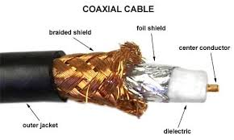
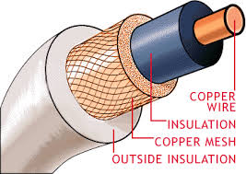

Slide 4
When rating feed lines for loss, we use “decibels (dB) per 100 feet.” If you’re not familiar with the decibel, don’t worry. Just remember that the higher the decibel number, the greater the loss.

Slide 5
RG-8X
RG-8X is a low loss, low cost, 50-ohm coax that WILL handle 1500 watts. Losses on HF are only slightly higher than RG-213, yet RG-8X is the same size as RG-59 (about 1/4" in diameter).
Combine LOW cost, LOW weight, and LOW loss and you have what amounts to a VERY BEST BUY!
Applications
Use with all HF wire antennas. It is suitable for any HF installation including beams. Use on VHF only for short runs of less than 50 feet. due to its flexibility, it makes excellent jumpers and is perfect for mobile installations.
Connectors
PL-259
BNC

